Slide 1
Angular project

Slide 2
Nutrition diet
P.Kiran Kumar
19001200

Slide 3
Introduction
Nutrition diet is the practice of consuming food in a balanced and healthy way to provide the body with essential nutrients, such as carbohydrates, proteins, fats, vitamins, and minerals, necessary for growth, development, and maintenance of overall health. A well-balanced nutrition diet helps to reduce the risk of chronic diseases, such as obesity, diabetes, heart disease, and cancer, and improves mental and physical well-being. The ideal nutrition diet emphasizes whole, minimally processed foods such as fruits, vegetables, whole grains, lean proteins, and healthy fats while minimizing intake of added sugars, saturated and trans fats, and sodium.

Slide 4
Login Page
implementation

Slide 5
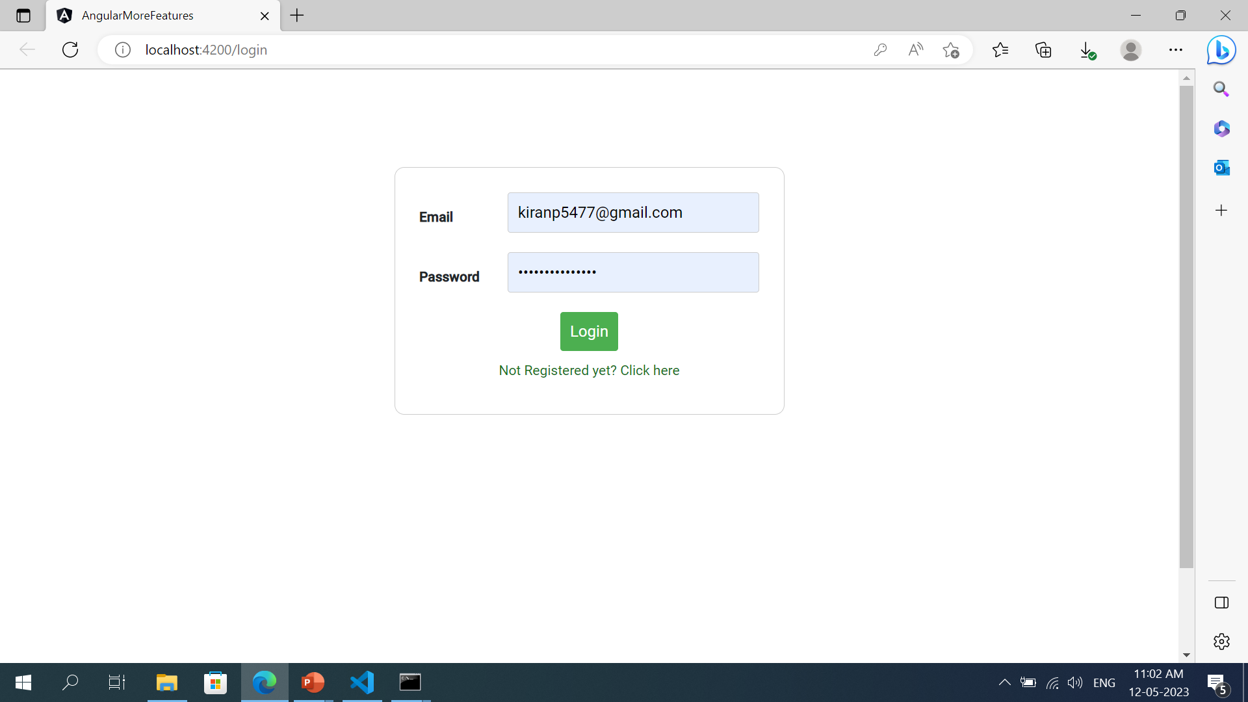
Login page
Functionalities
Not Register Yet
Click here
Login button
User login
Admin login
Techniques used
Template based approach
Validation
Material Module
Toggle Function
Lazy loading
Http Get, post

Slide 6
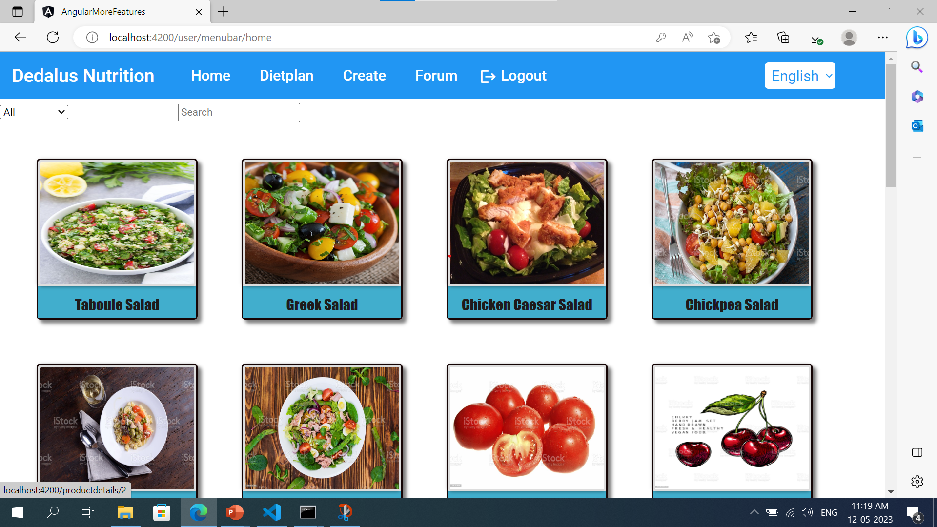
User-menubar
Functionalities:
Home
Dietplan
Create
Forum
Logout
internationalization

Slide 7
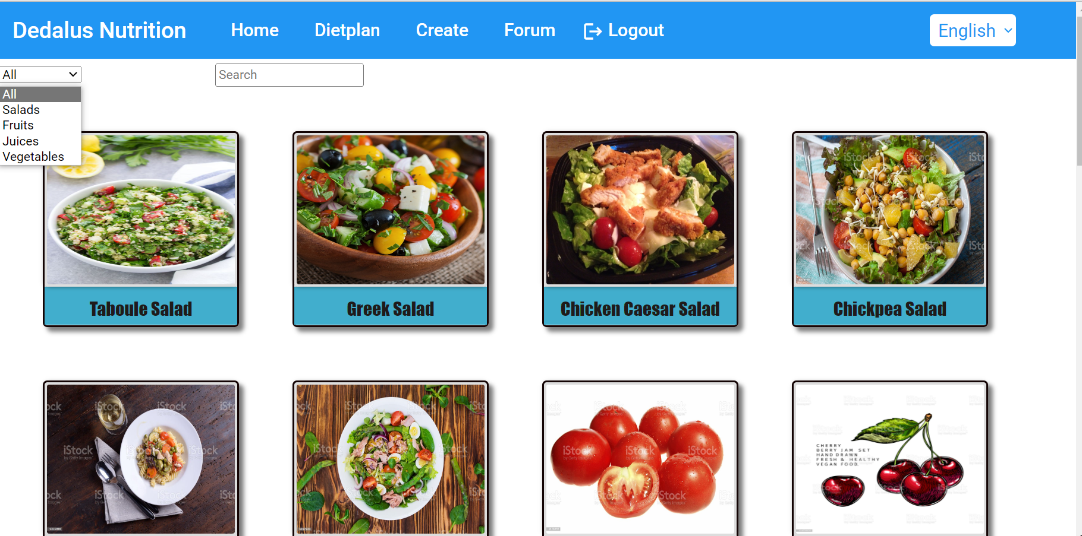
User Home
Functionalities:
Search bar
Type filter
Nutrition types:
Fruits
Vegetables
Salads
Juices

Slide 8
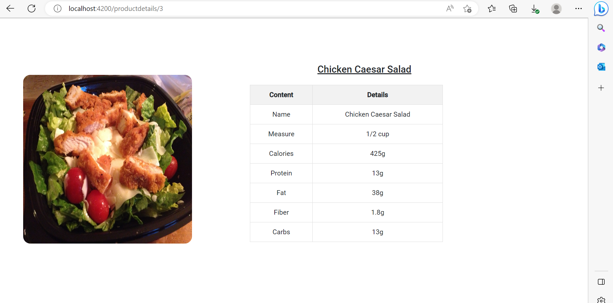
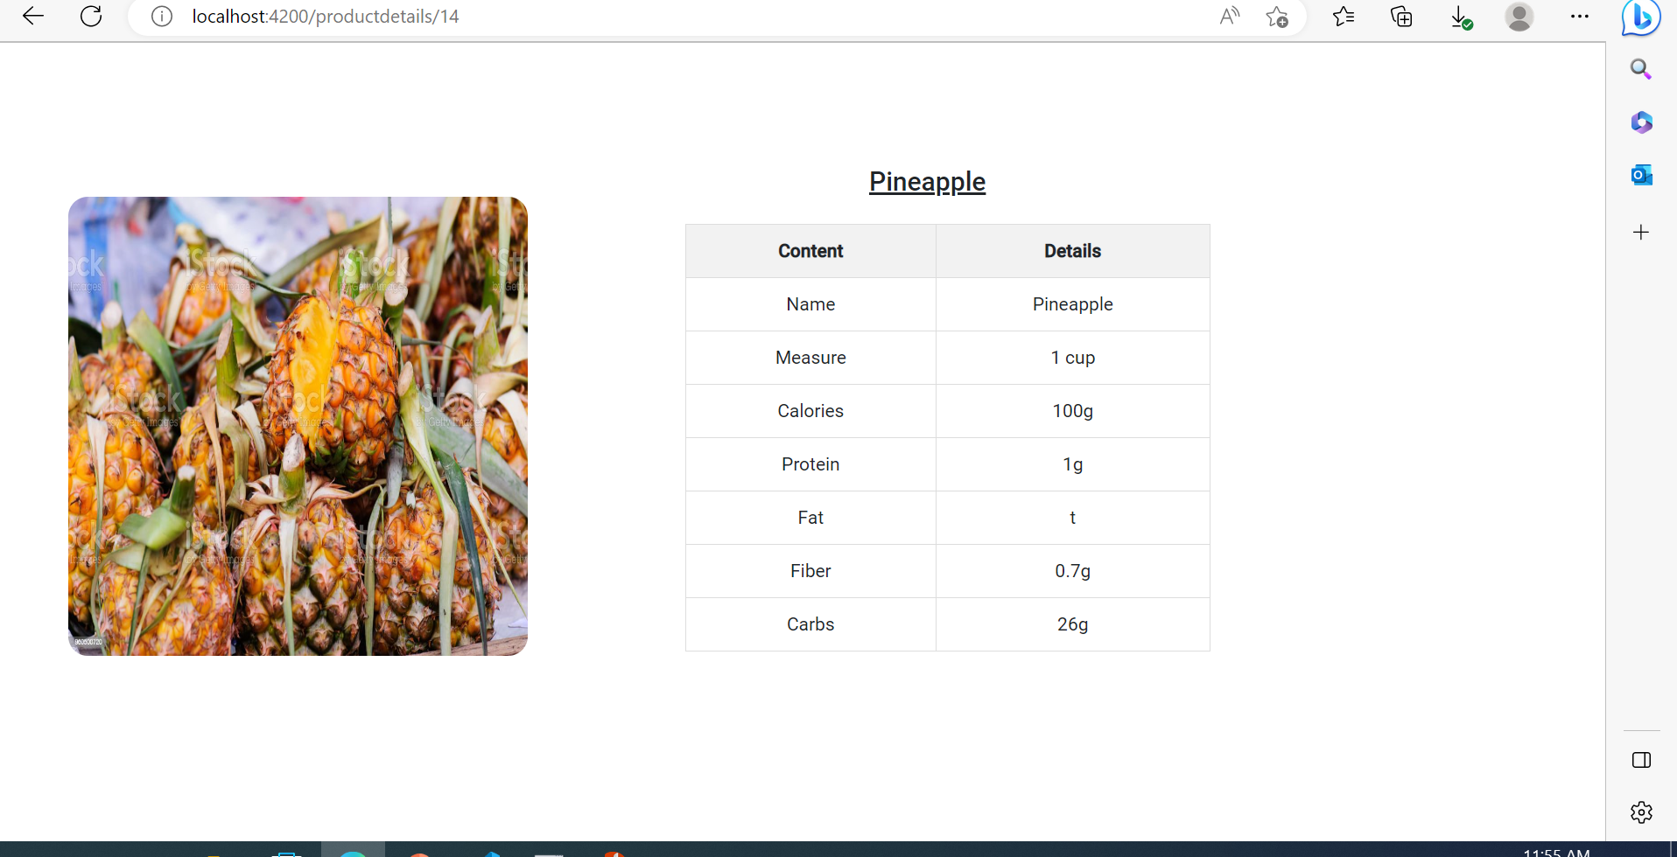
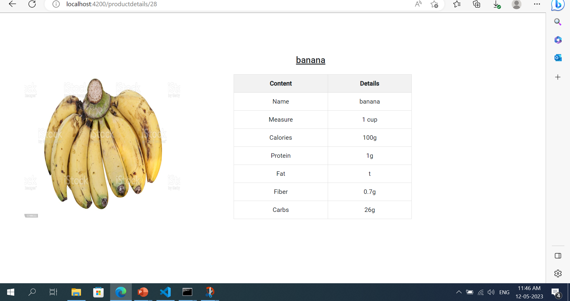
Home product details
If we click the product in Home we can get the product details like which is shown in the image.

Slide 9
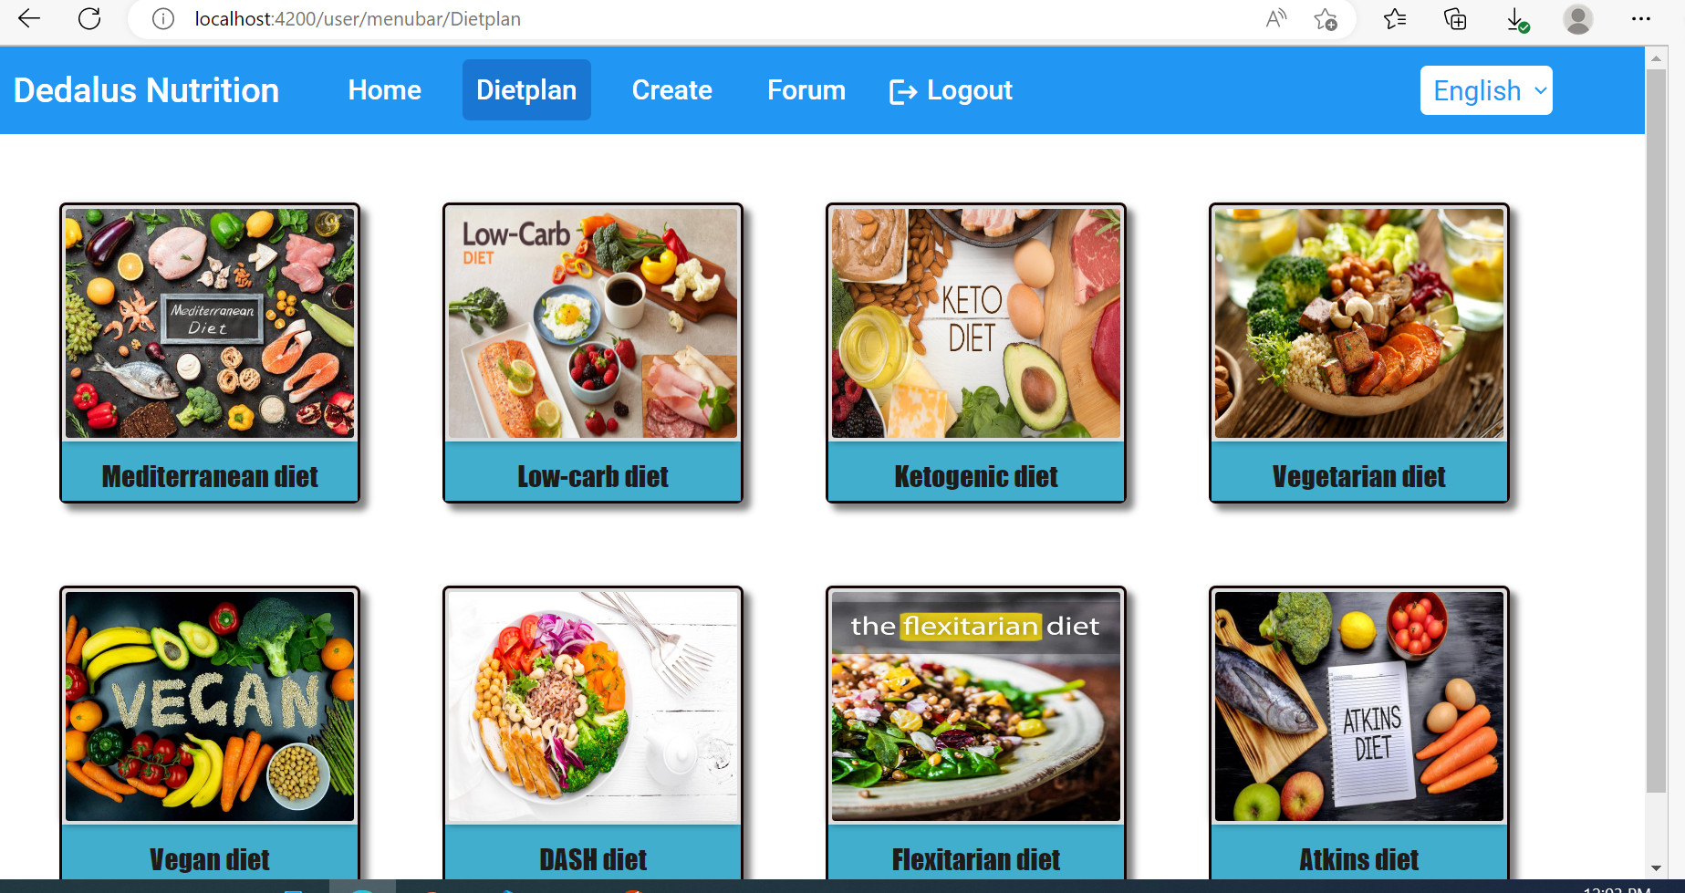
User DIETPLAN
Types of diet plans:
Mediterranean diet
Low-carb diet
Ketogenic diet
Vegetarian diet
Vegan diet
DASH diet
Flexitarian diet
Atkins diet

Slide 10
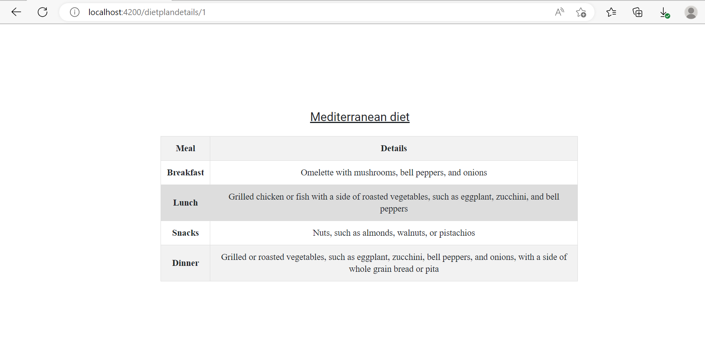
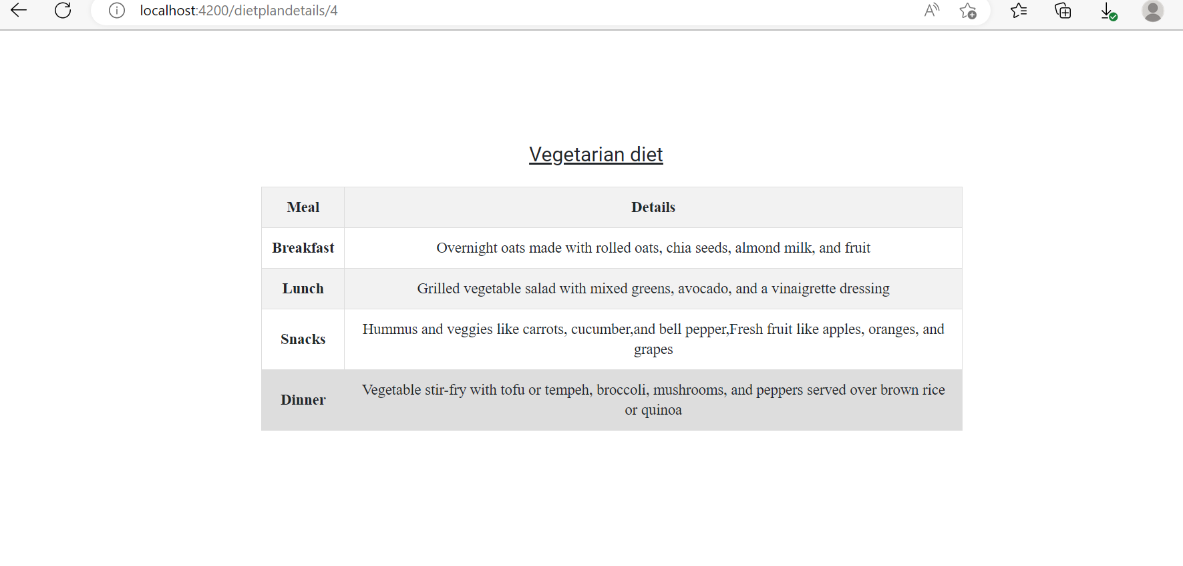
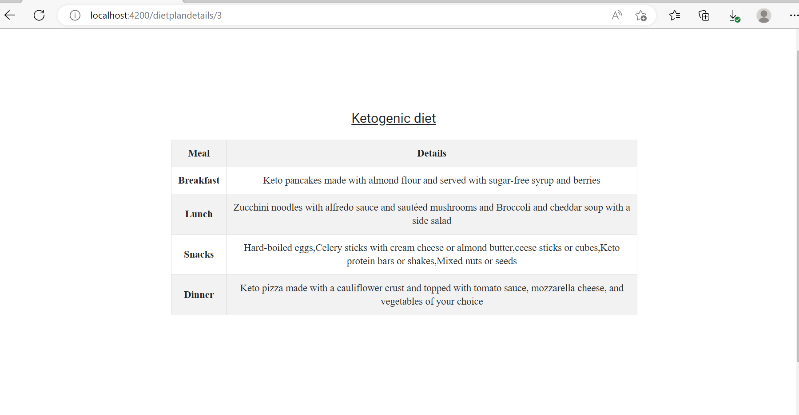
Home dietplan details
If we click the dietplan we can get the product details like which is shown in the image.

Slide 11
Thank you

Slide 12
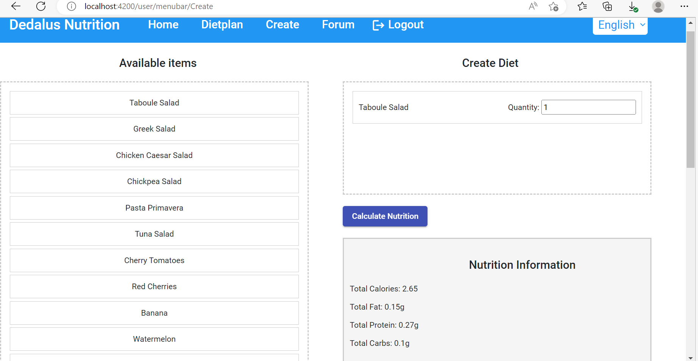
Create
12
Functionalities:
Available items
Create diet
Calculate nutrition
Here I can use drag and drop

Slide 13
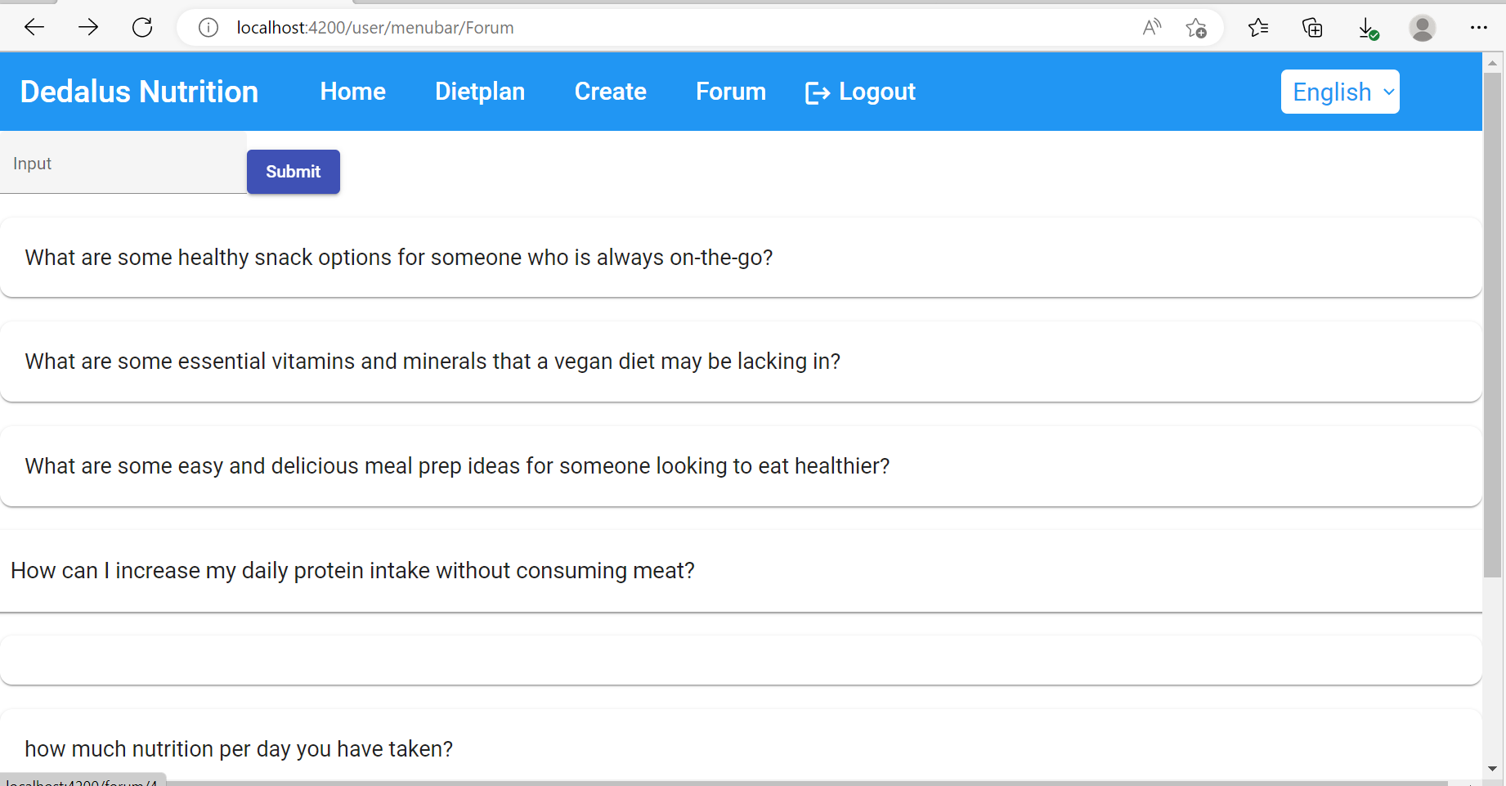
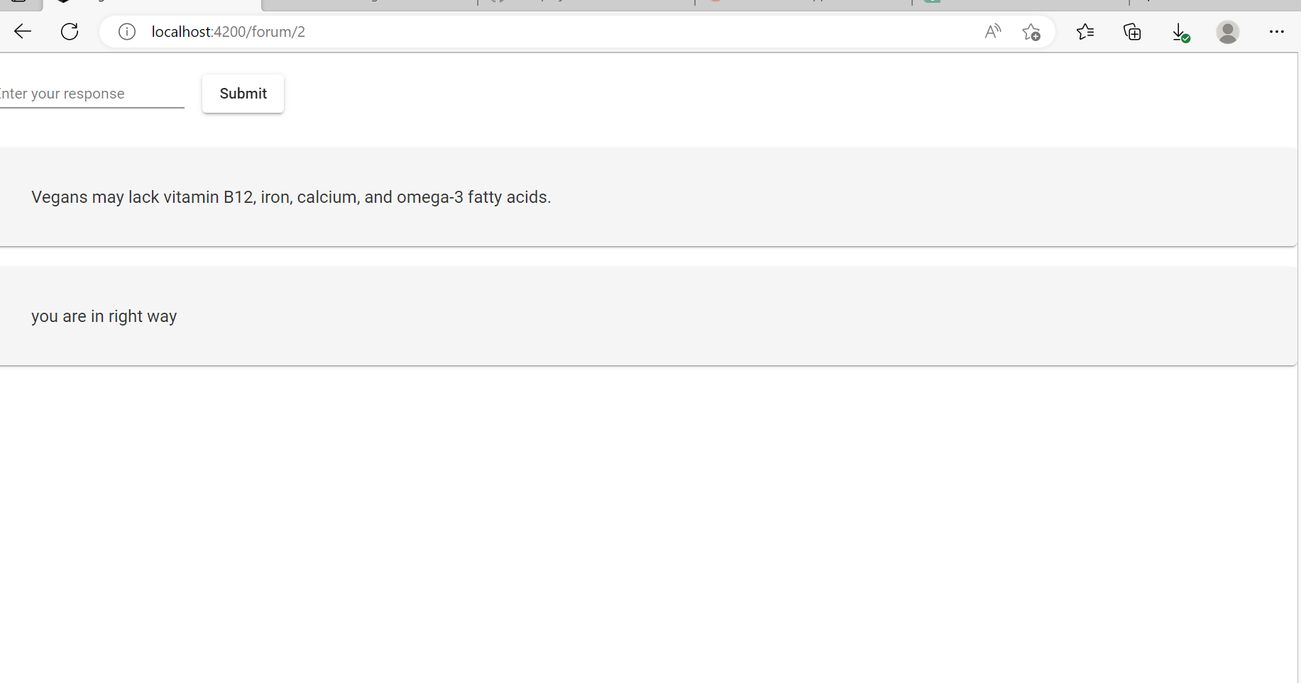
Forum page
13
On the forum page, users have the ability to post questions and receive answers from other users. Additionally, they can also view responses provided by the admin. Meanwhile, the admin is able to view and reply to any questions or answers posted by users.

Slide 14
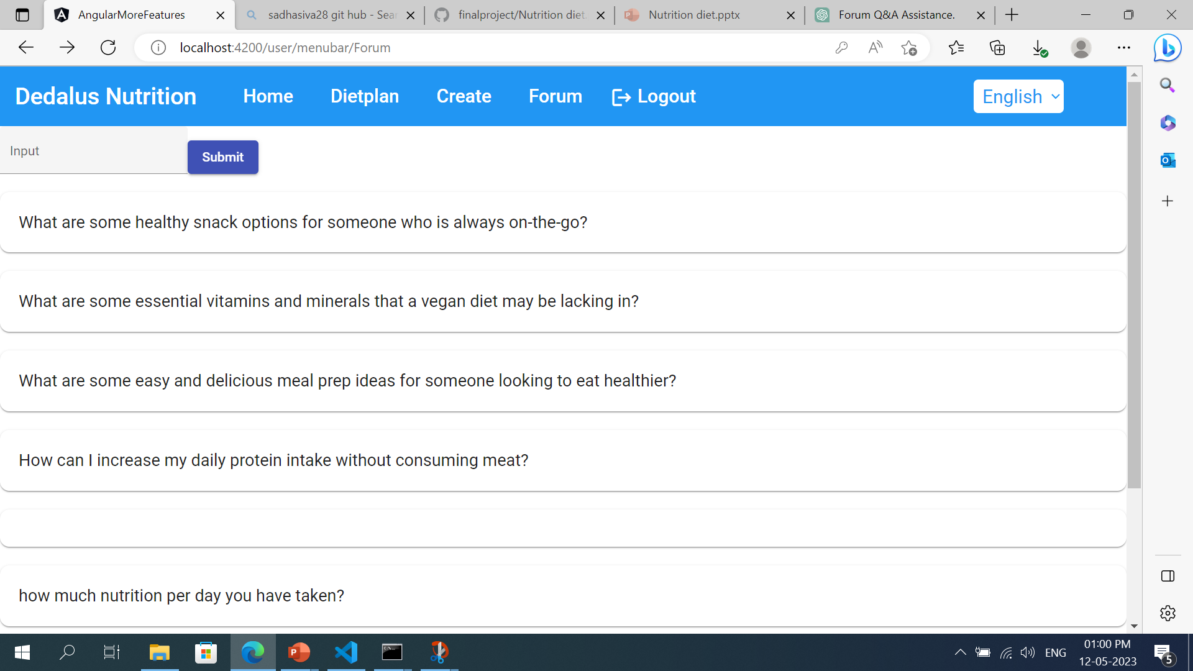
Logout page
Finally when we click log out button finally it came out f the website

Slide 16
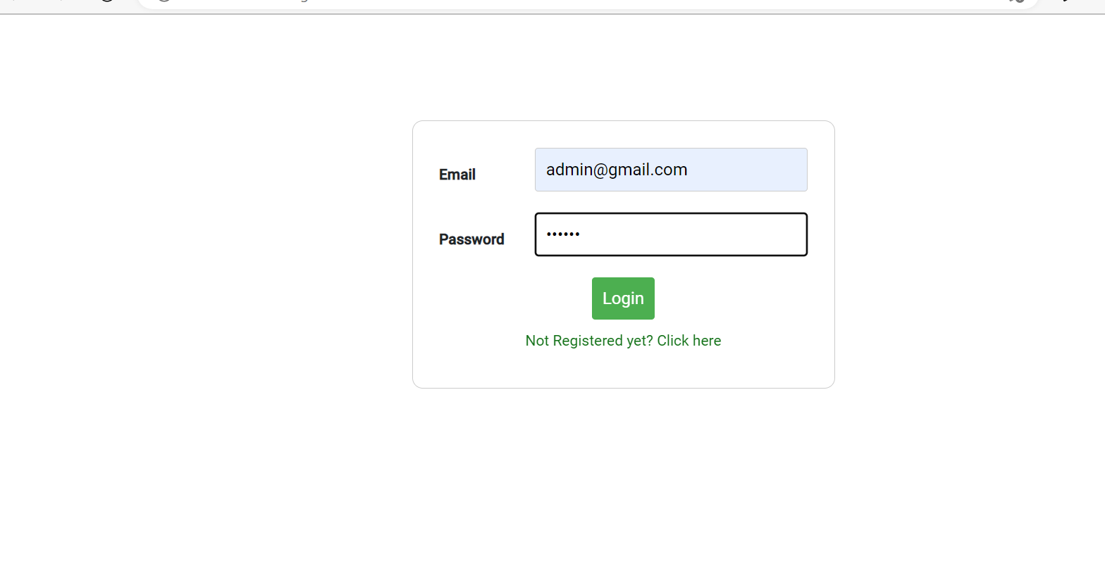
Admin login page
Functionalities
Not Register Yet
Click here
Login button
User login
Admin login
Techniques used
Template based approach
Validation
Material Module
Toggle Function
Lazy loading
Http Get, post

Slide 17
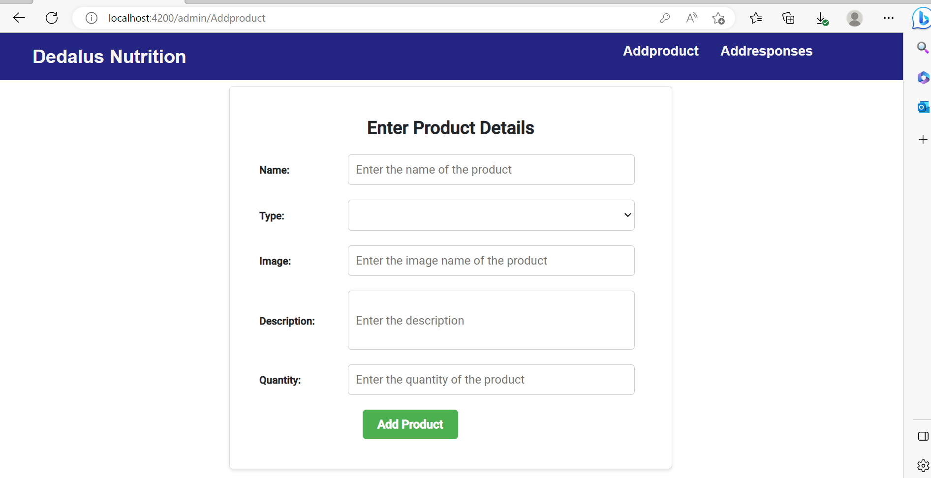
ADMIN MENU BAR:
Addproduct
Addresponse
Addproduct: In addproduct we have to add new project it will reflect in user home also.So in admin module admin can add the products

Slide 18
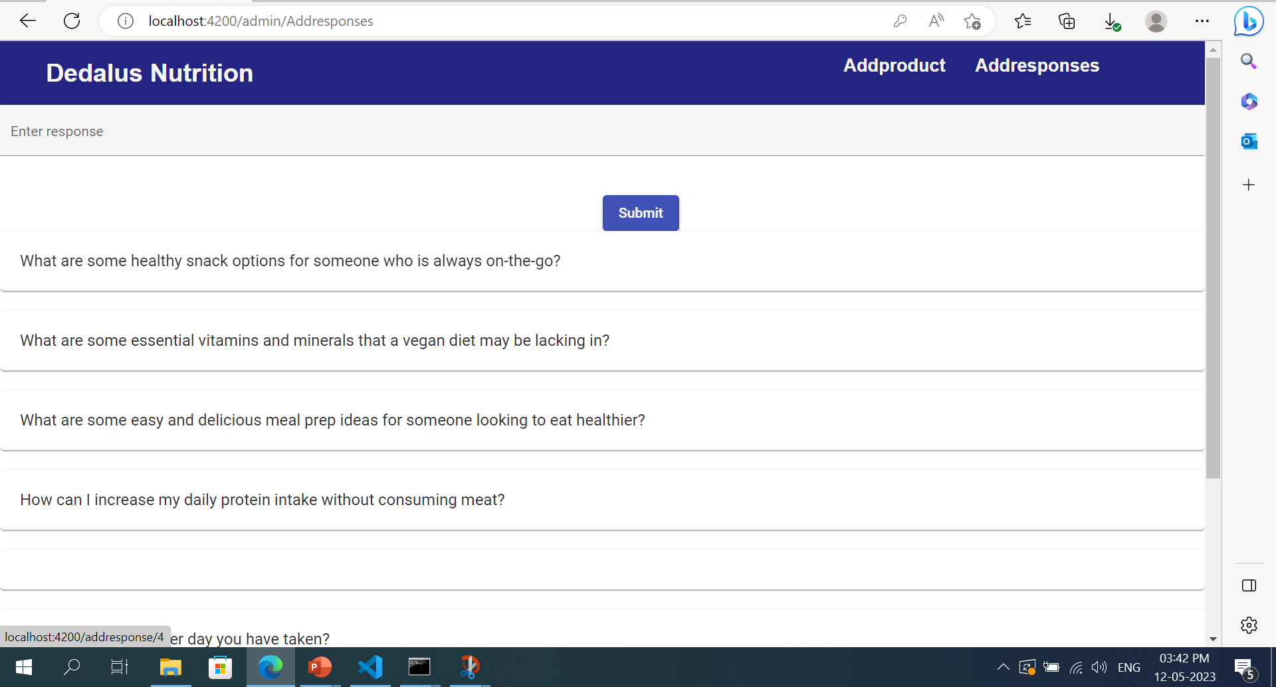
Addresponse:
In Addresponse admin can reply the responses which are posted by the users and admin also can post questions these are refleted in users forum page

